Slide 1
UKIEPC 2016
Post-Contest Presentation rgl@google.com

Slide 2
UKIEPC Numbers
2013: 52 teams; 5 sites 2014: 61 teams; 9 sites 2015: 142 teams; 12 sites 2016: 171 teams; 13 sites
First correct submission: 00:03:36 – Grass Seed Inc, IRL (Cambridge) Last correct submission: 04:59:23 – Fridge, @ tvoj otec (Southampton) Number of submissions: 1433
506 lines of code to solve the whole set.

Slide 3
UKIEPC Names
Organisers: Max Wilson, James Davenport, Rachid Hourizi
Writers: Robin Lee, Jim Grimmett, James Stanley
Reviewers: Ximo Lerma, Per Austrin
Sysadmins: Neil Francis, Matt Richards, Rob Perkins
Illustrator: Lisa Abose

Slide 4
Fun Facts
We restarted the domjudge server 3 times during this contest
We had 2 judgehosts fail after the 3rd restart (but we brought them back!)
We threw away 1 question a week before the contest

Slide 5
Problem Solutions

Slide 6
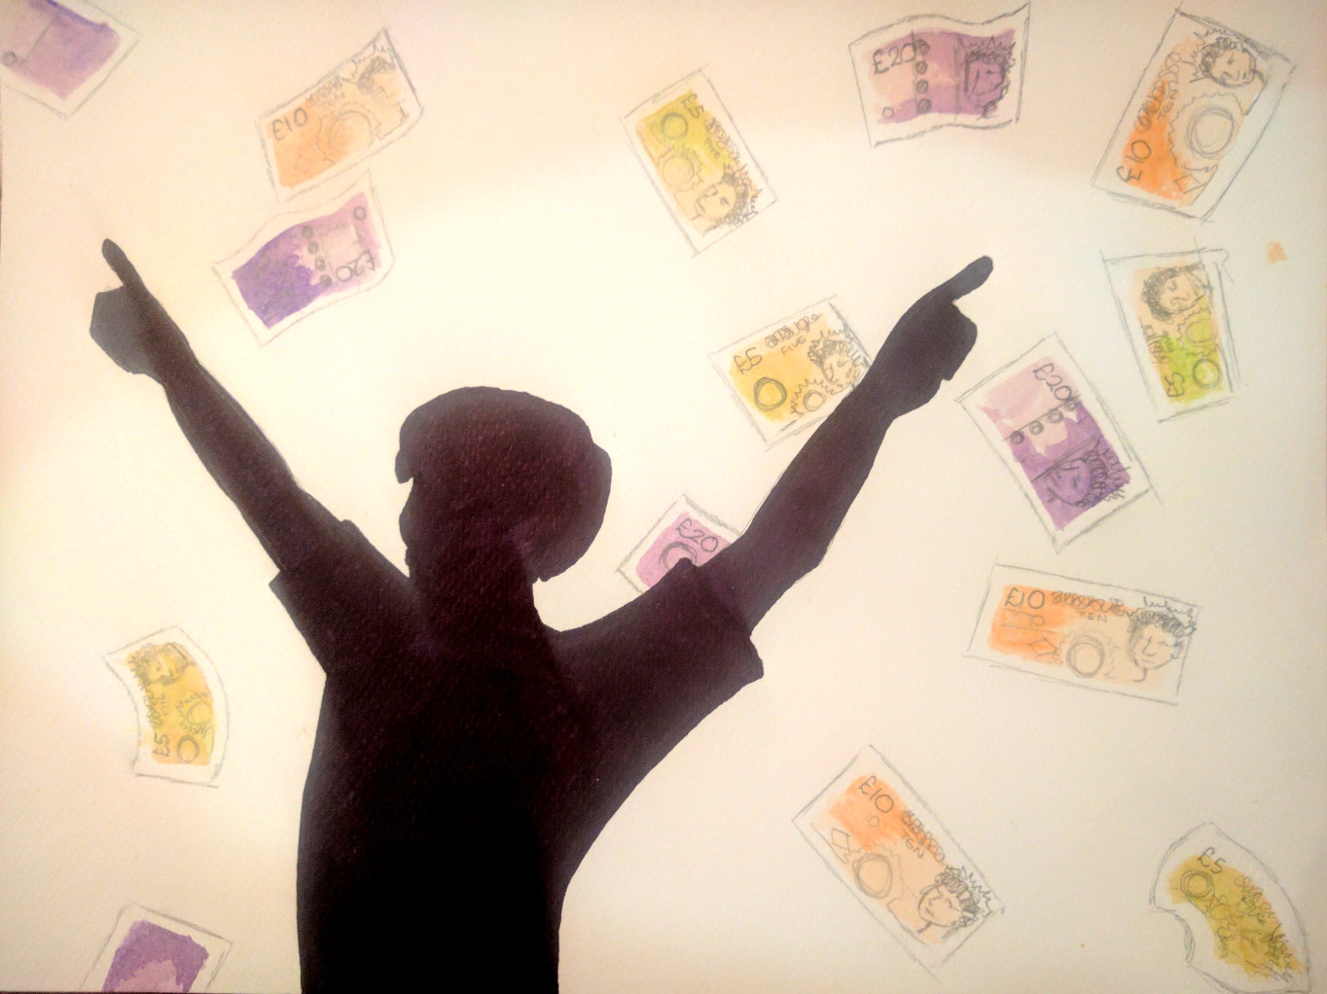
A - Taxing
Overview
A number of tax bands, each with a certain tax percentage.
A number of friends with earnings and net present size.
Determine the gross present size for each friend.
30 correct • solved at: 00:35 by
Just To Fail One More Time (Taras Shevchenko)
Author: Jim

Slide 7
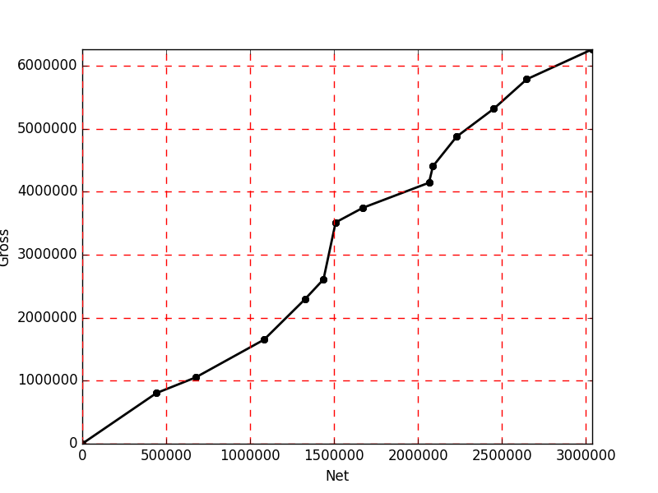
Taxing Problem - Solution
Techniques
Algorithm
Geometric series
Binary search
For each friend, ‘fill-up’ tax bands one-by-one.
Start filling up the first tax band with any space left.
If the gift will not fit in this first band, work out the tax on this part of the gift and move onto the next tax band.
If the gift does fit, calculate tax, and tax on tax, etc. If that total would leave us in the same band, we are done.
If not, work out what portion of the tax will overlap, move to the next band and repeat.

Slide 8
B - Build a Boat
Overview
Given a polygon with edges going strictly left-right (a monotone polygon)
Partition the polygon into as many equal slices as possible, above a minimum size
1 correct • solved at: 04:34 by
Catz CS Society (Oxford)
Author: Robin

Slide 9
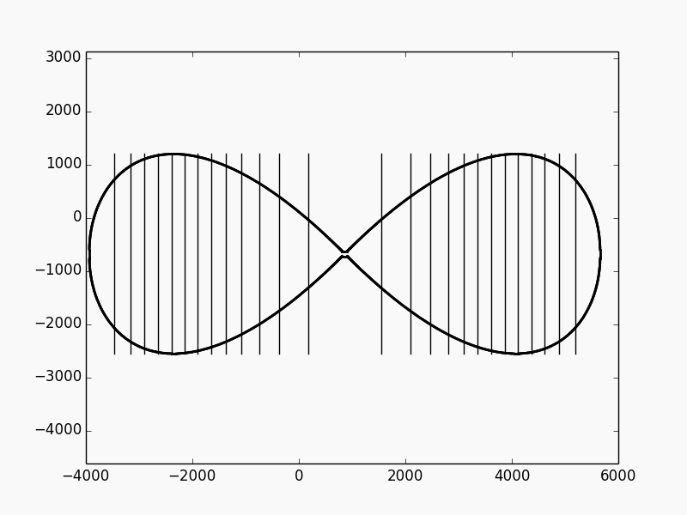
Build a Boat - Solution
Techniques
Algorithm
Polygon area
Integration
Binary search
Create a function that takes a width, crops the polygon vertices to that width, and calculates its area, eg. with cross-products:
total_area = sum(vertex[i] x vertex[i+1]) / 2
Precompute the function for every “interesting” width (X coordinates of vertices) and interpolate in between
Work out segment sizes from total area:
segment_area = total_area / floor(total_area / min_area)
Run binary search repeatedly to find the segment positions, given the areas they need to occupy

Slide 10
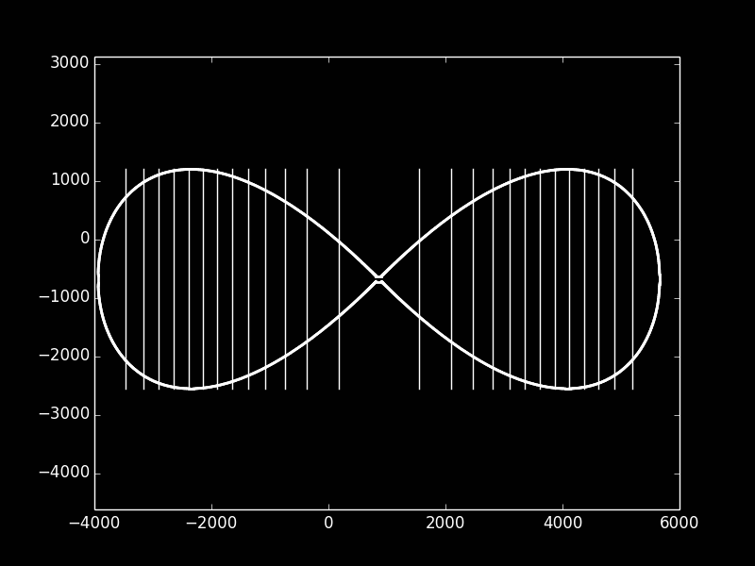
C - Compiler
Overview
A simple processor supplied with limited instructions, three registers, and a small stack.
No program can be longer than 40 instructions.
Write a program that will write the assembly language to output a number between 0 and 255
4 correct • solved at: 02:36 by
Catz CS Society (Oxford)
Author: Robin

Slide 11
Compiler - Solution
Techniques
Algorithm
Dynamic programming
Shortest paths
3 registers and 256 bytes of stack is overkill. All we need is:
2 registers
1 item on the stack
Let state={X,Y,Stack1} --- that’s 257³ = 16,974,593 choices
Breadth-first search over all possible CPU states
Worst case: 38 instructions
Another approach from Per
Factorise one register recursively via (PH S)*T, AD*(x-1), PL
Worst case: 40 instructions

Slide 12
D - Darkness
Overview
Wall off badly lit areas of a nightclub
You may also wall off well-lit areas, but this comes at a hefty price
Not solved
Author: Jim

Slide 13
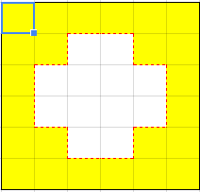
Darkness - Solution
Techniques
Algorithm
Minimum cut
Maximum flow
Fractions
Find the cheapest way of cutting off the “inside” from the “outside”
£11 to remove an edge between adjacent cells
£43 if the cells were both lit
First, find which cells are above the threshold
One big loop is fine
Next, add edges between cells for fence costs
And infinite edges from Source for boundary cells
And infinite edges to Sink for unlit cells
Solve with your favourite maxflow algorithm

Slide 14
E - Showroom
Overview
A map of a car showroom with doors, cars and walls.
There can be many doors in the outer wall leading to the target.
Given the coordinates of a car in the showroom, how many cars must be moved in total.
48 correct • solved at: 00:19 by
Me[∰]tallica (Cambridge)
Author: Jim

Slide 15
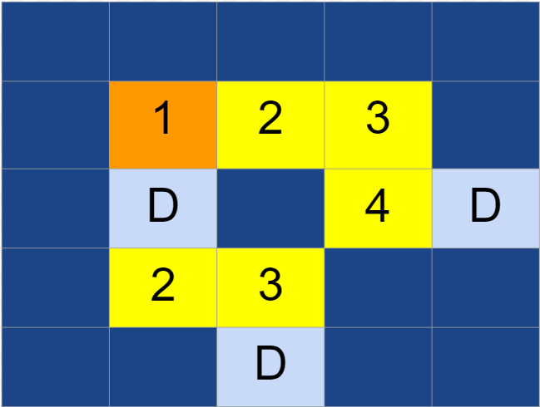
Elegant Showroom - Solution
Techniques
Algorithm
Dijkstra’s algorithm
Breadth-first search
Read in the ‘map’ of the showroom and build a graph. Make a note of the doors on the edges.
Use Dijkstra’s algorithm to find the distance to the target car.
Weight each node. 1 for a car, 0 for a door.
Push all of the edge doors onto a priority queue at once, distance 0
Starting a new search from each door is slow.
About 1,500 times slower, in fact.
See also: Sokoban for a harder challenge with the same idea

Slide 16
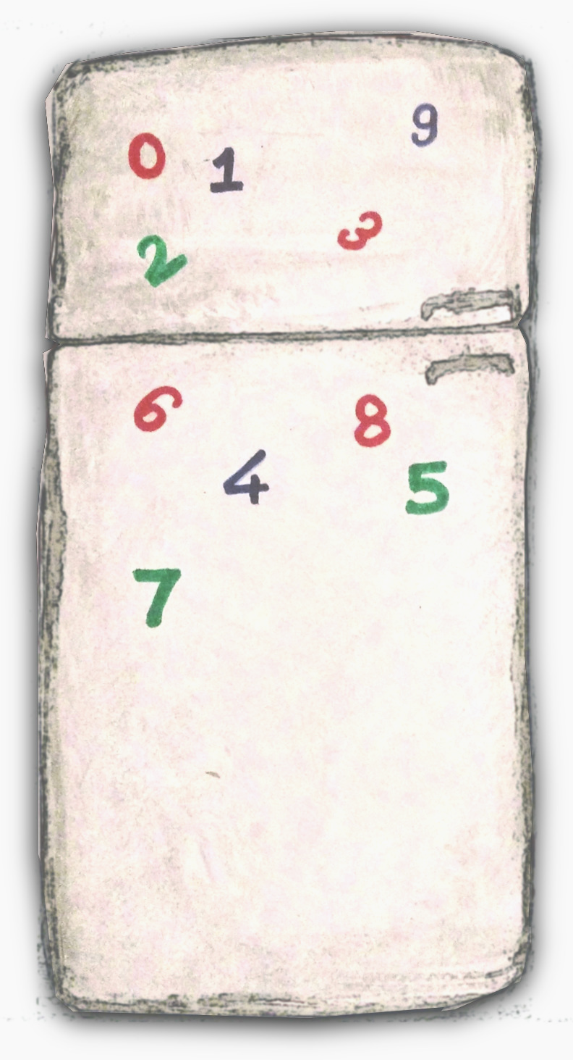
F - Fridge
Overview
A single string of up to 1000 digits [0-9].
Print the smallest positive integer that cannot be made without reusing any of those digits.
Example:
01123456789 → 22
114 correct • solved at: 00:12 by
Charles University in Prague
Author: Robin

Slide 17
Fridge - Solution
Techniques
Algorithm
Counting
Strings
Find the digit with the fewest occurrences
The answer will be the digit repeated * (occurrences + 1)
But in the case of zero, the answer has to be positive
So prepend a “1” as well
Done!
Note: “up to 1000 digits” is a little too much to read into an unsigned long
And also slightly too large for iterating over all possibilities to work
100...000
111...111
222...222
333...333
444...444
555...666
777...777
888...888
999...999

Slide 18
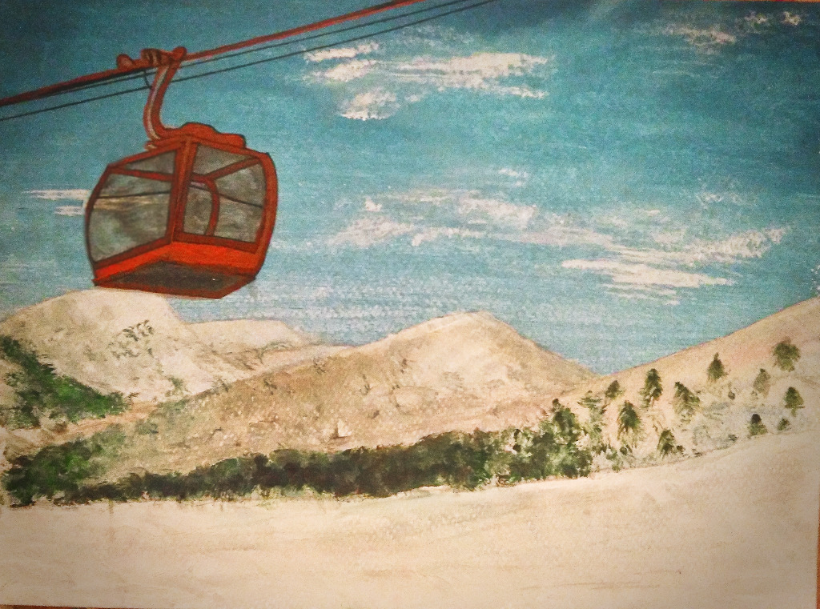
G - Gondola
Overview
People arrive at a mountain foot at certain times
They would like to get on their gondolas quickly
You have a limited number of gondolas and must place them on the rotating track
Minimise the sum of all waiting times
Not solved
Author: Robin

Slide 19
Gondola - Solution
Techniques
Algorithm
Modular arithmetic
Dynamic programming
Convex hull trick
First observations:
Arriving at time X is equivalent to arriving at time X+2×T
Gondolas should always coincide with someone arriving
Assume we put the first gondola at X=2xT so cost=sum(arrivals)
We can add another gondola at time Y<X
This saves (X-Y) × count(arrival[i] <= Y)
And now we have a smaller instance
Dynamic programming takes O(N^3)
Or O(N²) by using convexity properties
One wrinkle: 2xT may not be the best place to put a gondola
So wrap the array around and try other end times

Slide 20
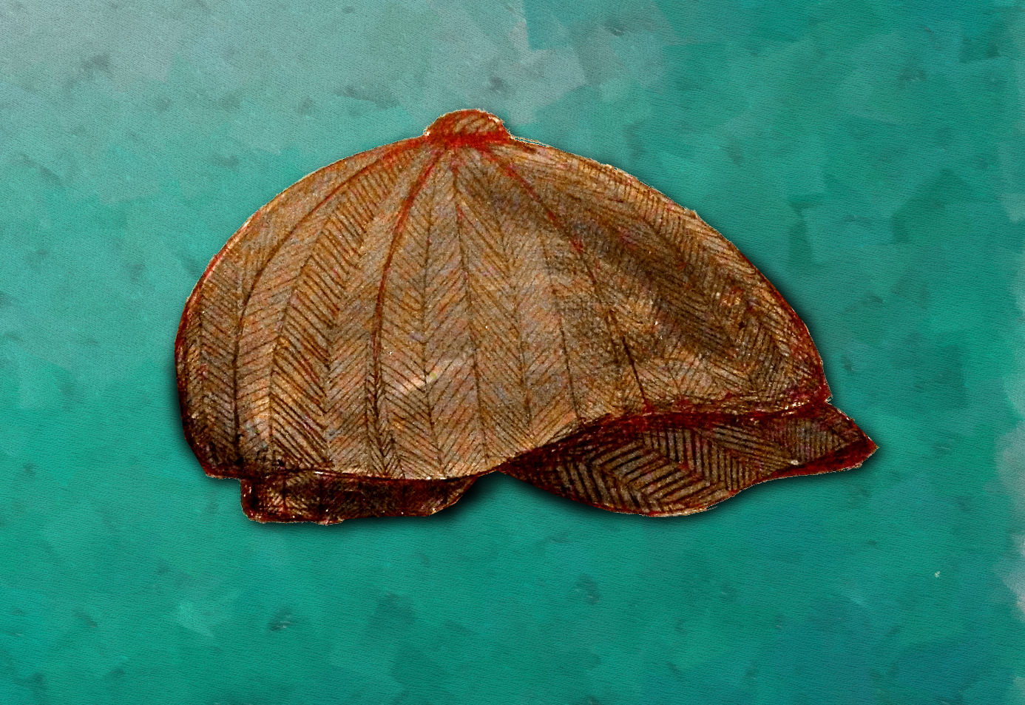
H - Rhyming Slang
Overview
Read a number of lists of word endings. If two endings are in the same list words with those endings rhyme.
Read a single common word and a number of possible phrases that could be rhyming slang for the common word.
Output YES if the word and phrase rhyme, NO otherwise.
93 correct • solved at: 00:17 by
ill_overflow_ur_NaN_m8 (Trinity College Dublin)
Author: Jim

Slide 21
Rhyming Slang - Solution
Techniques
Algorithm
Substrings
Hashmaps
Read in all of the endings and the common word.
We only care about rhyming sets where the common word matches at least one ending in the list.
Put the set of possible rhymes into a hash set.
For each possible rhyming phrase iterate over all possible suffix lengths for the end word.
Look them up in the hash set.
If any exist in there (possibly more than 1), write YES.

Slide 22
I - Grass Seed
Overview
Given:
The cost of seed for one square metre of lawn
Several lawn widths and lengths
Calculate the total cost of seed.
161 correct • solved at: 00:03 by
IRL (Cambridge)
Author: Jim

Slide 23
Grass Seed - Solution
Techniques
Algorithm
Floating point
Multiplication
For each lawn:
Read in width and height
Multiply to find the area
Sum the lawn areas.
Multiply the sum by the cost of the seed.
Print back out with %.6f, %.7f, etc.

Slide 24
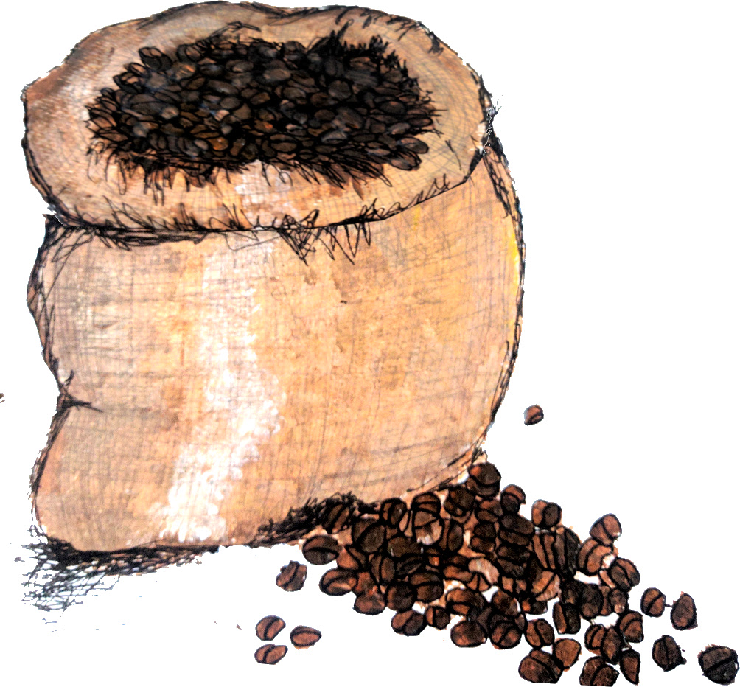
J - Jack’s Beanbag
Overview
N farmers each have a set, X
When asked, they will yield one item
But you can’t pick which one
You want a certain number of each kind of bean
After utilising the farmers’ supplies, how many more beans will you need to barter for?
16 correct • solved at: 02:10 by
KTU United (Kaunas University of Technology)
Author: Robin

Slide 25
Jack and the Beanbag - Solution
Techniques
Algorithm
Brute force
Combinations
Set cover
Each farmer will give the full amount of at least one kind of bean.
Proof by induction: either you already had enough, or getting another bean brings Jack one step closer.
The worst case is when farmers collude:
Each picks a kind of bean to always give and puts it in set S
Cost = sum(beans \ S)
There are at most 2^{B} such sets---generate all of them, check if each makes a valid farmer selection, and take the smallest.
This is known as the set cover problem
Complexity: O(2^{B} × N)

Slide 26
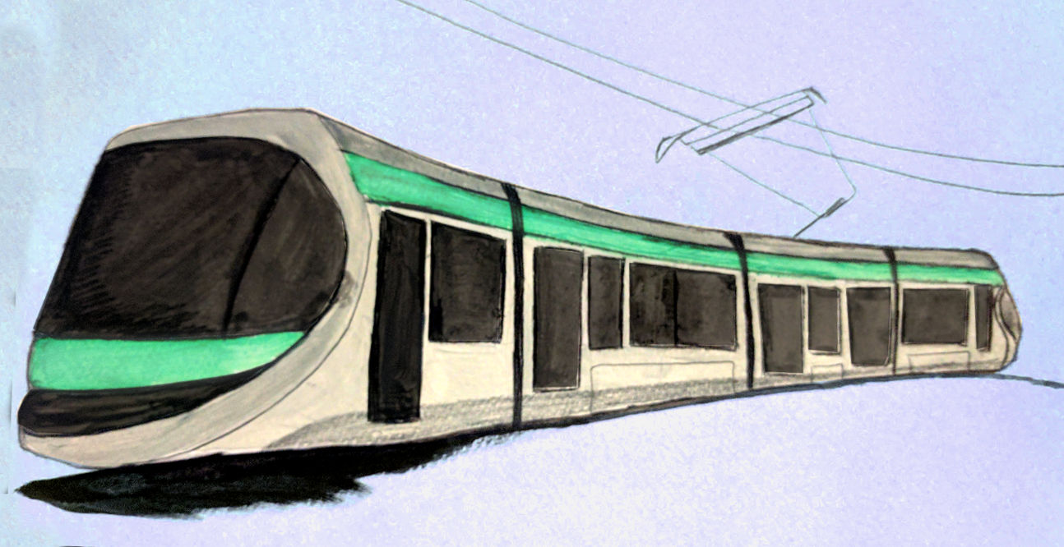
K - Compensation
Overview
Trains are scheduled at times X, Y
But they are delayed, so actual departure/arrival times are X+C, Y+C
What is the earliest train journey we can book so we are “delayed” by more than 1800 seconds?
2 correct • solved at: 02:10 by
Charles University in Prague
Author: Robin

Slide 27
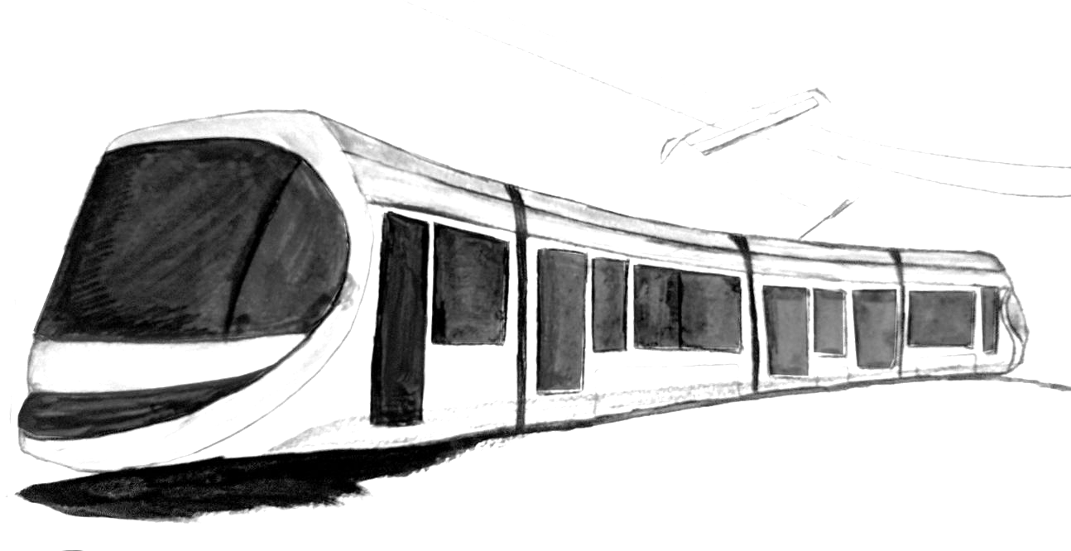
Compensation - Solution
Techniques
Algorithm
Dynamic programming
Shortest paths
Graphs
Make two separate graphs, one “regular” version and one “delayed” version
For every start train in the “regular” graph, find the shortest path provided we board exactly that train
(note: we booked it, so even if there’s a faster way, we must take the train we were scheduled to)
This caused a big sea of WRONG-ANSWER.
Cache and reuse repeated answers for {station,time}
Another fun fact: we found a wrong judge solution halfway through. Luckily it was not the one we use for validating test data.

Slide 28
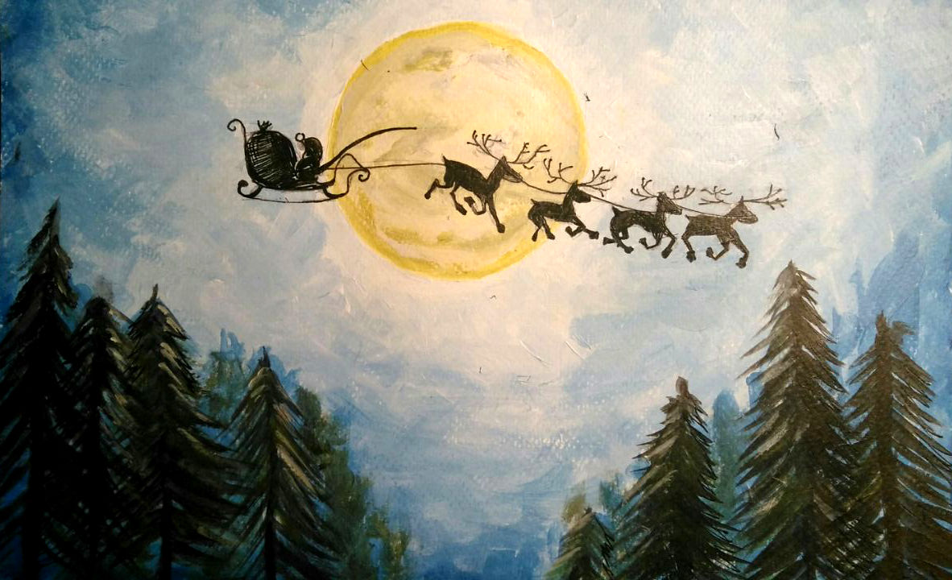
L - Secret Santa
Overview
We have N people in a town.
Each person picks up a unique name from the set, on a piece of paper
What are the chances that someone (maybe several people) picked up their own name?
61 correct • solved at: 00:11 by
IRL(Cambridge)
Author: James

Slide 29
Secret Santa - Solution
Techniques
Algorithm
Dynamic programming
Permutations
Infinite series
Count the number of permutations with no fixed points
(also known as derangements)
With N people, whoever person 1 gives a gift to may:
Give a gift in return
In which case answer[N] += answer[N-2] * (N-1)
Give a gift to someone else
In which case answer[N] += answer[N-1] * (N-1)
Dynamic programming gives a fast solution for small N
But N <= 10^12
Handily, the answer quickly converges to 1-(1/e)
After 8 in fact---so brute force works too

Slide 30
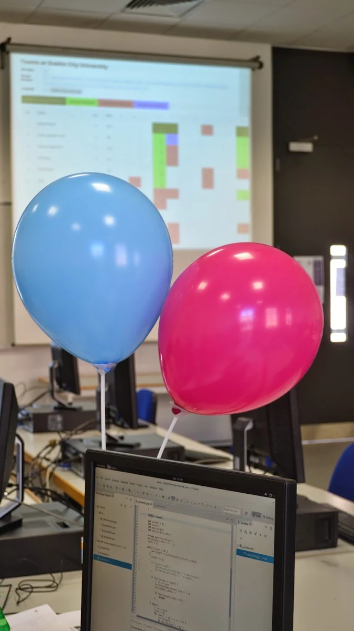

Slide 31
Questions?
Or comments?

Slide 32
Final Standings
http://domjudge.bath.ac.uk/

